Slide 1
COLIEE Task 2
Hao Sun

Slide 2
Data Parse
For Entailment Law Cases data
Input target cases and candidate paragraphs data from text files
181 target cases, ‘fact.txt’ are input as representatives of each case
Input all candidate paragraphs data of each case by os.listdir()

Slide 3
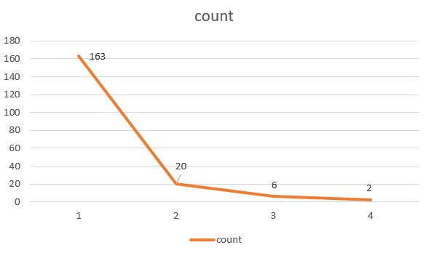
Data Parse
For Target data
Extract data from XML file to build training target list

Slide 4
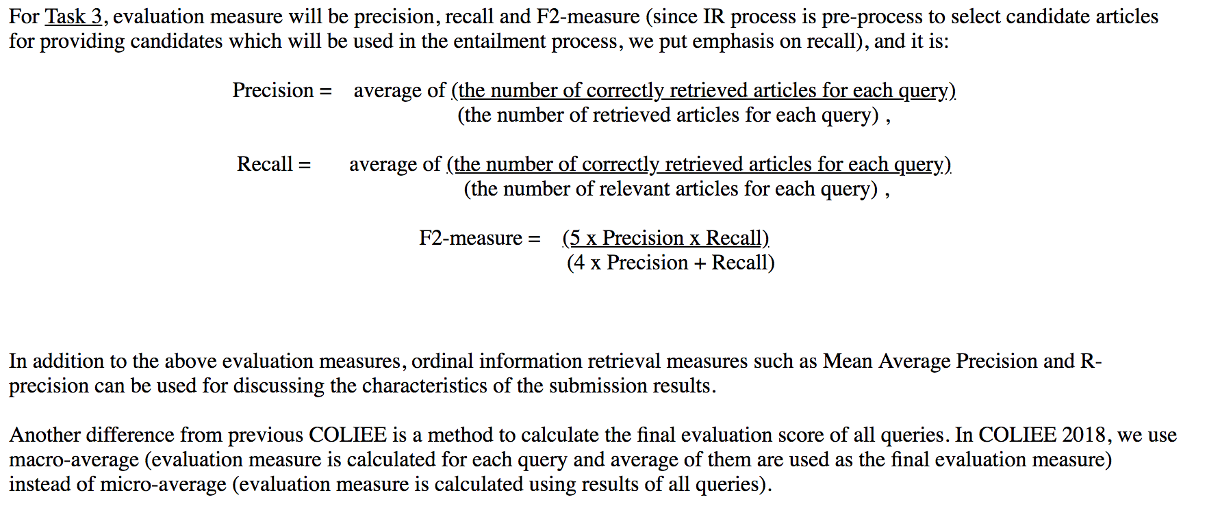
Performance Calculation

Slide 5
Model 1: Association Rule – Baseline Model
Count Vectorizer calculate 2-gram term frequency for target and candidate paragraphs
Calculate intersection and union set length
Ranking Score = intersection length/union length ranking score
Calculate ranking score of target cases and their candidate paragraphs and sort

Slide 6
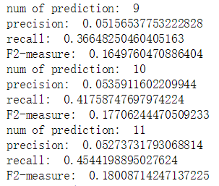
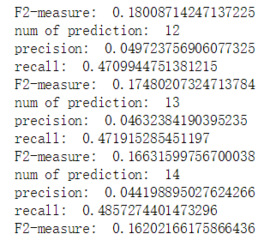
Model 1: Association Rule – Optimized Model
Improvement: calculate 2-gram term frequency rather than 2 (min_df=0,ngram_range=(1,1) )
Calculate ranking score of target cases and their candidates and sort
Best performance:

Slide 7
Model 2: Word2Vec and Random Forest
Gensim Doc2Vec to generate 50 numbers long vectors of target cases and candidate paragraphs. Doc2Vec is trained by all texts in task 2.
Build dataset contain relevant case-paragraph set with label ‘1’, and randomly picked irrelevant case-paragraph set with label ‘0’
Utilize random forest to predict the relevance label.(max_depth=20, random_state=0, n_estimators=100)
Apply 70% of the dataset as training data, 30% as testing data
Model performance is not good, the F-2 measure is below 2%

Slide 8
Model 3: Word2Vec and Association Score
Include the Ranking score in Association Rules model as a feature to the previous random forest model
Utilize random forest to predict the relevance label(max_depth=20, random_state=0, n_estimators=100)
Apply 70% of the dataset as training data, 30% as testing data
Model performance has improved by 2 times, the best F-2 measure is around 4%

Slide 9

Result:
The best performance is the association rules model with prediction number of 11.
Applying stop words, high frequency terms or 2-gram terms can not improve accuracy of predicting relevance between cases and short texts like paragraphs.
Among all attempts, 1-gram terms have the best performance.

